Slide 1
Introduction to Fairness
Dr. Debashish Das

Slide 2
What We Will Cover?
Conception of Fairness in AI
Fairness Issues Need to be Addressed by AI
Individual & Group Fairness, and Tension
between Each
Fairness, Privacy, and Transparency
Example of Unfairness in AI
Unfairness in Model: Bias Amplification
Fairness in Automated Decisions
Discrimination
Unfairness in Machine Learning
Subtler Bias
Data Issues
Unfairness in Data Collection
Unfairness in the World
Demographic Disparities
Model Issues
Fair Classification
How do we make a fair model?
Add Fairness Constraints
Machine Learning Pipeline
Fairness in ML : Goals
Stages of ML System
Further Thoughts
Summary

Slide 3
What We Will Cover in Module 1?
Introduction to Fairness
Fairness of Data, Algorithms & Models
Individual Fairness, Group Fairness, and the tension between them
Fairness, Privacy, and Transparency by Design in AI/ML Systems

Slide 4
Conception of Fairness in AI
Fairness and Equality are critical aspects in the various domains like Governments, Credit, Advertising, Recruiting etc.
With the widespread use of artificial intelligence (AI) systems Fairness has gained significant importance
AI systems can be used in many sensitive environments to make even life-changing decisions
It is vital to ensure that the decisions do not reflect discriminatory behaviour toward certain groups or populations
Fairness in AI refers to the process of correcting and eliminating algorithmic bias (race, ethnicity, gender, sexual orientation, disability, and class) from AI models

Slide 5
Fairness Issues Need to be Addressed by AI
Data (input)
--Inaccurate or insufficient data
--Underrepresentation
Models (output)
--Discriminatory treatment of subpopulations
--Build or “post-process” models with subpopulation guarantees
--Not fully causally related variable that are correlated to the protected class
Algorithms (process)
--Learning algorithm generating data through its decisions
--Lack of clear train/test division

Slide 6
Individual & Group Fairness, and Tension between Each
At an individual level, fairness can be defined as similar individuals being treated similarly
At a group level, a fair outcome demands the existence of parity between different protected groups, such as those defined by gender or race
These measures can give rise to conflicts in situations where, in an attempt to satisfy group fairness, individuals who are similar with respect to the classification task, receive different outcomes
In practice, the conflict may be resolved by a nuanced consideration of the sources of `unfairness' in a particular deployment context, and the carefully justified application of measures to mitigate it

Slide 7
Fairness, Privacy, and Transparency
First, can we trust technology to be fair, especially given that the data on which the technology is based are biased in various ways?
Second, whom can we blame if the technology goes wrong, as it inevitably will on occasion?
Finally, does it matter if we do not know how an algorithm works or, relatedly, cannot understand how it reached its decision?
Although, the above are serious concerns, they are not irresolvable

Slide 8
Example of Unfairness in AI
Why was I not shown the Advertisement?

Slide 9
Example of Unfairness in AI (Cont.)

Slide 10
Unfairness in Model: Bias Amplification

Slide 11
Unfairness in Model: Bias Amplification
A model demonstrates bias amplification if the prior distribution of the model’s predictions does not match that of the data. Here, the aim of the model is to avoid creating or exaggerating disparities in the training data

Slide 12
Fairness in Automated Decisions
Algorithmic unfairness: Algorithms are pervasive, high-stakes, high-impact
Need more than just “accuracy”
What’s changed? Pervasiveness of ML & Attention to demographic Criteria

Slide 13
Discrimination
It is the concern
Population includes minorities
--Ethnic, Religious, Medical, Geographic
Protected by Law, Policy, Ethics
If we cannot completely control our data, can we regulate how it is used, how decisions are made based on it?

Slide 14
Forms of Discrimination
Steering minorities into higher rates (advertising)
Redlining: deny service, change rates based on area
Self-fulfilling prophecy: select less qualified to “justify” future discrimination

Slide 15
Subtler Bias

Slide 16
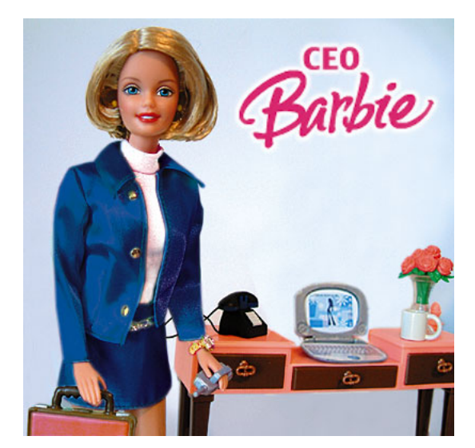
Subtler Bias

Slide 17
Data Issues
Basic data issues: imbalanced, impoverished; noisy
Measurement involves subjective choices, and technical difficulties
Example: “Even With Affirmative Action, Blacks and Hispanics Are More Underrepresented at Top Colleges Than 35 Years Ago.” NYT, 2017
--%age change 1980-2015 in black, Hispanic, Asian, white, multiracial students
Target variable / labels:
-- what is “creditworthiness”; “good employee”; “attractive”
-- objective measures may be biased too
-- classification schemes may rely on historical taxonomies
Even images not unbiased
-- color balance, dynamic range settings distribution of subjects not matching in training/testing

Slide 18
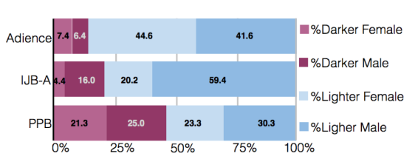
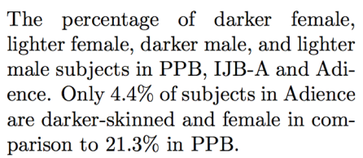
Unfairness in Data Collection
Nikon blink-recognition always thinks Asian faces are blinking
--While it’s not certain why the problem exists (Nikon has not given concrete explanation), it’s feasible that it is due to unbalanced training data

Slide 19
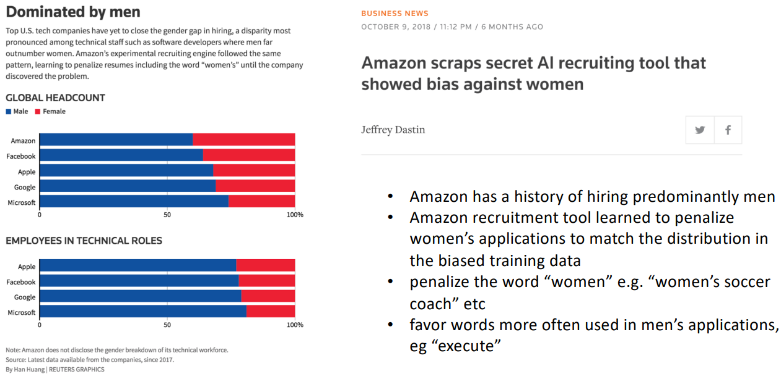
Unfairness in the World: Amazon Recruitment

Slide 20
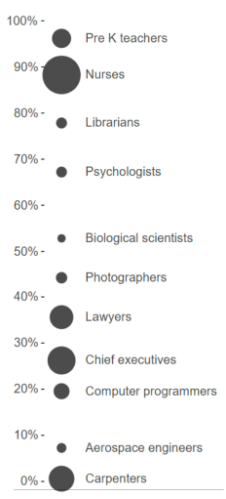
Demographic Disparities
Most ethical issues arise when data concerns people
Training data tends to encode demographic disparities in our society -- can perpetuate stereotypes
Some occupations have stark gender imbalance -- why?
But not all applications involve people. Or do they? examples: StreetBump; Automated Essay Scoring; Zillow

Slide 21
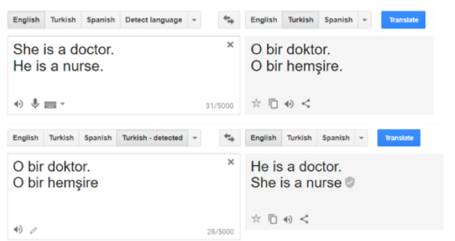
Model Issues
Models can faithfully reflect disparities in data, often including stereotypes – why?
Some patterns we think are good features for classification, others are not: how to tell them apart?
Can also introduce disparities when none exist – not enough data
Need to train based on something other than just overall accuracy

Slide 22
Fair Classification
Explosion of fairness research over the years
Fair classification is the most common setup, involving:
-- X, some data
-- Y, a label to predict
-- Ŷ, the model prediction
-- A, a sensitive attribute (race, gender, age, socioeconomic status)
We want to learn a classifier that is:
-- accurate
--fair with respect to A

Slide 23
How do we make a fair model?
Try to ensure our model doesn’t augment bias
Train with a balanced dataset
Audit your model
Ensure some constraint, e.g. demographic parity
Don’t use protected attribute

Slide 24
What happens if we take out the protected attribute?
Neighborhoods in America are largely racially segregated
A race-blind model could still act in a discriminatory manner by using zipcode to e.g. deny a loan
Even unintentional discrimination can occur in this way, given a biased prior

Slide 25
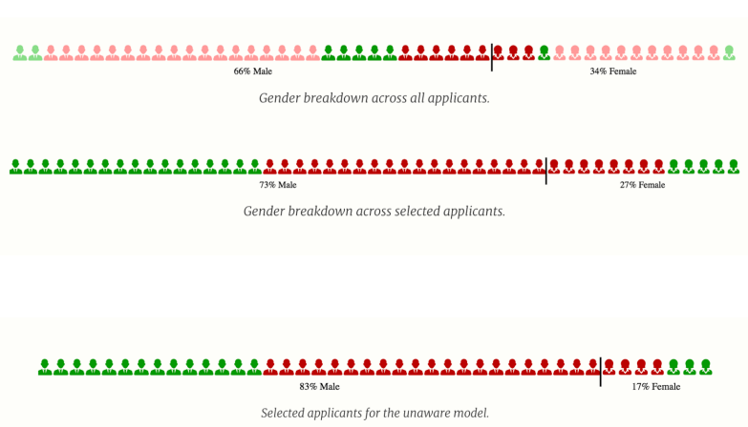
In fact, taking out the protected attribute can be detrimental to fairness goals
Imagine an AI for hiring new employees has two features: gender and experience.
-- The model hires 27% women, despite their being 44% of the applicant pool.
In an effort to make a fair model, you take out the gender variable and only use experience
-- You find your model now hires 17% women.

Slide 26
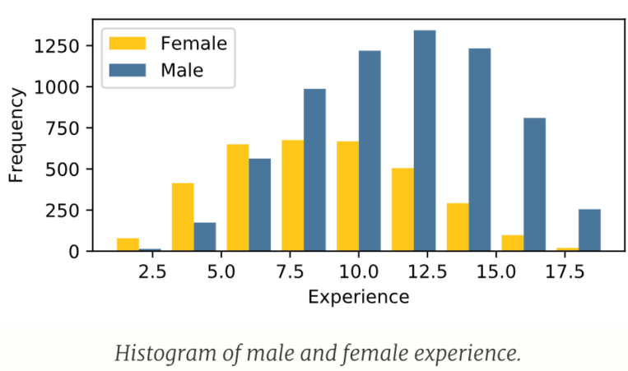
In fact, taking out the protected attribute can be detrimental to fairness goals (Cont.)
Perhaps in reality, people with over ten years of experience are equally qualified for the job
Women have to take off more time due to extenuating circumstances (needing to take family or child leave, etc)
Removing the gender feature from the model makes it impossible for the model to compensate

Slide 27
Add Fairness Constraints
Demographic Parity: proportion of people who get good outcome/bad outcome should be equal across all groups
Equal False Positive/False Negative Rates (all confusion matrix scores)
Equalized Odds: The protected attribute and the prediction are conditionally independent given the ground truth: i.e., the rates of loan application acceptances should be the same across groups among people who are truly credit-worthy
Individual fairness constraint: similar people should be treated similarly

Slide 28
Problems with fairness constraints
They don’t always lead to the fair outcomes you think they should either!
Refer to Measure and Mismeasure of Fairness (Corbett-Davies and Goel) and Delayed Impact of Fair ML (Liu and Hardt)

Slide 29
Machine Learning Pipeline

Slide 30
Fairness in ML : Goals
Identify and mitigate bias in ML-based decision-making, in all aspects of data pipeline

Slide 31
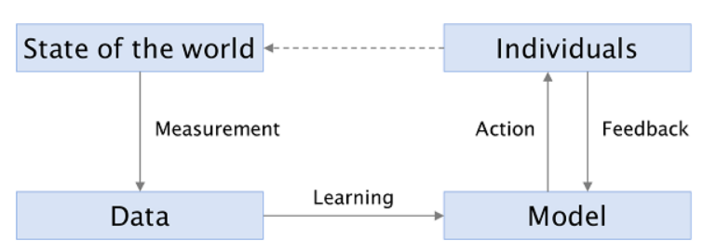
Stages of ML System
Measurement: process by which the state of the world reduced to a set of rows, columns, and values in dataset.
Learning: turns dataset into model
Action: based on model’s prediction (classification, regression, info retrieval), corresponding action
Feedback: user responses can update model (e.g., clicks)

Slide 32
Unfairness in Machine Learning

Slide 33
Further Thoughts: Individuals vs Groups
We can think about fairness in aggregate or individually
Group fairness: ideas like demographic parity, equalized odds: statistics for all groups should be the same
--But this doesn’t solve all problems
--What about intersectionality? You could accept the same number of black people and white people to college, but accept no black women
--Increase disparities within a subgroup: e.g. make it easier for wealthy or otherwise privileged black people to get into college, but make it just as hard or harder for low income students of color
Individual fairness: similar people should be treated similarly
--What does it mean for two people to be similar?

Slide 34
Further Thoughts
ML systems evolve the system that they are deployed in, but ML algorithms do not take this shift into account
PredPol/ ACLU arguments against its use: sending policemen to already overpoliced areas could further perpetuate the cycle of disproportionate incarceration in America
But similarly, careless “fair” algorithms could lead to their own problems
--Consider a ”fair” lending algorithm that lent to the same number of people from groups A and B, where B is disadvantaged. If those in group B are not actually qualified for a loan and default, you actually hurt that population more, and also prevent their being qualified in future because they defaulted

Slide 35
Further Thoughts: Delayed Impact of Fairness
Liu and Hardt paper, Delayed Impact of Fair Machine Learning
How can we make fair algorithms that take into account the way they change the data landscape over time?
What if instead of applying some blindness constraint, or demographic parity constraint, to an algorithm, we instead directly optimize for improving the lives of the affected group over time?

Slide 36
Summary
Fairness becomes a very popular topic in ML community in recent years
Fairness matters because it has impact on everyone’s benefit
Unfairness in ML systems is mainly due to human bias existing in the training data
No consensus on “the best” definition of (un-)fairness exists

Slide 37
Further Reading
Barocas, S., Hardt, M. and Narayanan, A., 2019. Fairness and Machine Learning. fairmlbook. Org
Junzhe Zhang and Elias Bareinboim. Fairness in decision-making — the causal explanation formula. In Proc. 32nd AAAI, 2018
Fang, Y., Liu, H., Tao, Z. and Yurochkin, M., 2022, October. Fairness of Machine Learning in Search Engines. In Proceedings of the 31st ACM International Conference on Information & Knowledge Management (pp. 5132-5135).

